Slide 1


Slide 2



April Prayer Service
REJOICE

Slide 3
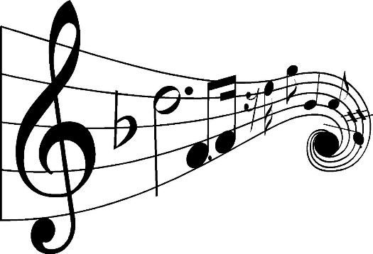
“Let All Things Now Living”
Catholic Book of Worship III #534
“Sing of the Lord’s Goodness”
Ernest Sands
https://www.youtube.com/watch?v=MvXeyUMg2ok
“Sing a Joyful Song”
Jim Farrell
https://youtu.be/_pRjnu_ACS0
“Goodness of God”
Bethel Music
https://youtu.be/-f4MUUMWMV4

Slide 4
Opening Prayer
God of abundance,
We are filled with joy as we remember all of the blessings, large and small, that you pour out on us every day;
The blessings of life and health, the blessings of family and friends, the blessings of peace and shelter, and especially the blessing of Catholic education.
In the midst of our world’s challenges and pain, keep us rooted in gratitude and rejoicing, and may we share generously with others, what you have so richly given to us.
Praise to you, O God, who takes such joy in us, and call us to be a people of Gospel joy for others.
In the name of Jesus our Lord.
Amen. +

Slide 5
A Reading from the Book of Psalms (105:1-6)
Give thanks to the Lord, proclaim his greatness; tell the nations what he has done. Sing praise to the Lord; tell the wonderful things he has done. Be glad that we belong to him; let all who worship him rejoice. Go to the Lord for help; and worship him continually. You descendants of Abraham, his servant; you descendants of Jacob, the man he chose; remember the miracles that God has performed!
The Word of the Lord. R. Thanks be to God.
Notes:
I added this Call to Prayer and Opening Prayer on the next slide which frames the reflective questions on slide 8

Slide 6
Reading Reflection
From Pope Francis’ weekly audience in the Vatican – December 30, 2020
“Above all, let us not forget to give thanks; if we are bearers of gratitude, the world itself will become better, even if only a little bit, but that is not enough to transmit a bit of hope. The world needs hope. And with gratitude, with this habit of saying, ‘thank you,’ we transmit a bit of hope. Everything is united and everything is connected, and everyone needs to do his or her part, wherever we are… There are those who do not give thanks and those who do; those who take everything as if it were owed to them, and those who welcome everything as a gift, as a grace. If we view life like this, then ‘thank you’ becomes the driving force of our day.”
Notes:
I added this Call to Prayer and Opening Prayer on the next slide which frames the reflective questions on slide 8

Slide 7
Questions for Personal Reflection
Pope Francis says that “everything is united and everything is connected, and everyone needs to do his or her part, wherever we are.” How do you as a Catholic educator feel called to reflect this in your own daily life?
What words or phrases in the reading resonate with you the most in terms of your role as a Catholic educator?
How do we celebrate the blessings in our lives? How do we intentionally acknowledge God as the source of those blessings?
Notes:
A reading from the book of Job (Job 12:7-10,13)
Ask the animals, and they will teach you; the birds of the air, and they will tell you; ask the plants of the earth, and they will teach you; and the fish of the sea will declare to you. Who among all these does not know that the hand of the LORD has done this? In his hand is -the life of every living thing and the breath of every human being … With God are wisdom and strength; he has counsel and understanding.
The Word of the Lord. (Thanks be to God)

Slide 8
Closing Prayer
God of grace,
Help us to rediscover how to be side by side in rebuilding our communities of faith and learning.
Help us restore harmony and balance in our relationships, and renew our desire to approach challenges confidently and with peaceful hearts.
May we always rejoice in recognizing the blessings our lives hold.
Amen. +
Notes:
A reading from the book of Job (Job 12:7-10,13)
Ask the animals, and they will teach you; the birds of the air, and they will tell you; ask the plants of the earth, and they will teach you; and the fish of the sea will declare to you. Who among all these does not know that the hand of the LORD has done this? In his hand is -the life of every living thing and the breath of every human being … With God are wisdom and strength; he has counsel and understanding.
The Word of the Lord. (Thanks be to God)

Slide 9
“Sing Hallelujah to the Lord”
Virtual Worship
https://www.youtube.com/watch?v=IBp1PYhHWC8
“Grateful”
Elevation Worship
https://youtu.be/oh2goMABFPc
“You are My Joy”
Will Reagan
https://youtu.be/cPacYSOjCbk
“But for Who You Fear My Name”
The Welcome Wagon
https://youtu.be/5f3kX25cUWM

